Slide 1
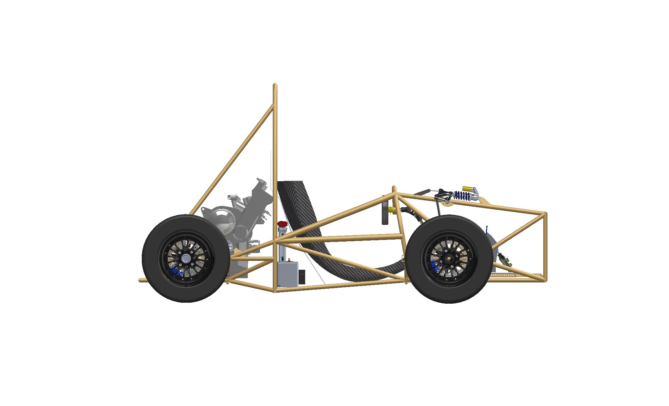

Formula SAE Design Project

Slide 2
Formula SAE Design Project

Slide 3
Formula SAE Design Project
By:
Charles Casey, Gavan Davis, Michael Ledyard, Matt Stewart, Kelly Valle, Dominique Vidal,
Andrew Vitale

Slide 4
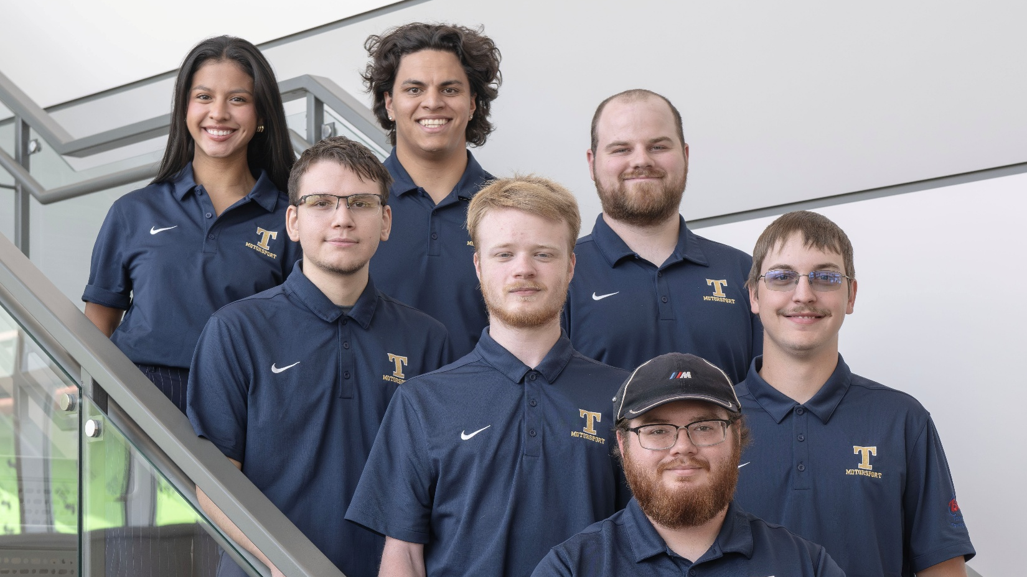
Kelly Valle
Steering Engineer

Slide 5
Dominique Vidal
Project Lead / Fundraising

Slide 6
Andrew Vitale
Steering Engineer

Slide 7
Charles Casey
Suspension Engineer

Slide 8
Matt Stewart
Brakes Engineer

Slide 9
Gavan Davis
Chassis Engineer

Slide 10
Michael Ledyard
Testing Engineer

Slide 11


Dr. Rizacan Sarikaya
Project advisor

Slide 12


Joe Thompson
Lab manager

Slide 13

Project Scope:
Design and build the rolling chassis of an open-wheel Formula car, including the frame, suspension, steering, and braking systems.

Slide 14
Project Scope:
Design and build the rolling chassis of an open-wheel Formula car, including the frame, suspension, steering, and braking systems.
Purpose:
Deliver a fully functional rolling chassis for Phase 2, where the powertrain, drivetrain, aero package, and electronics will be integrated for competition in the 2027 Formula SAE event.

Slide 15
Project Scope:
Design and build the rolling chassis of an open-wheel Formula car, including the frame, suspension, steering, and braking systems.
Purpose:
Deliver a fully functional rolling chassis for Phase 2, where the powertrain, drivetrain, aero package, and electronics will be integrated for competition in the 2027 Formula SAE event.
Rationale:
This project supports growth in the rapidly expanding U.S. motorsports industry.

Slide 16
Customer Requirements
Design a chassis capable of pulling 1.5g during cornering (in steady state).
Design a rolling chassis with a weight under 135 kg.
Design must complete all Phase One subsystems
Phase One: Frame, Suspension, Brakes, Steering
Phase Two: Powertrain, Drivetrain, Aero package, Electronics
Design must allocate space for Phase Two subsystems by allowing a minimum of 10% tolerance beyond the estimated size of the components.
Design must accommodate drivers from any size between the 5% female (5' tall) and 95% male (6' 1") percentiles.
Design a chassis that twists less than 20% roll compliance at maximum lateral load.

Slide 17
Customer Requirements
Design must pass 100% of the practical FSAE Tech tests applicable to Phase One subsystems.
Design must be completed by April 24, 2026.
There must be 0 safety infractions during the design and manufacture of the rolling chassis.
A minimum of $18,000 must be raised for the project.
Vehicle does not roll when tilted 60 degrees to the horizontal, corresponding to 1.7g cornering.​
Design must be made such of 25% or more of the rolling chassis weight is recyclable at the end of the vehicle’s life cycle.​

Slide 18
Design Solutions
Suspension
Chassis
Steering
Brakes

Slide 19
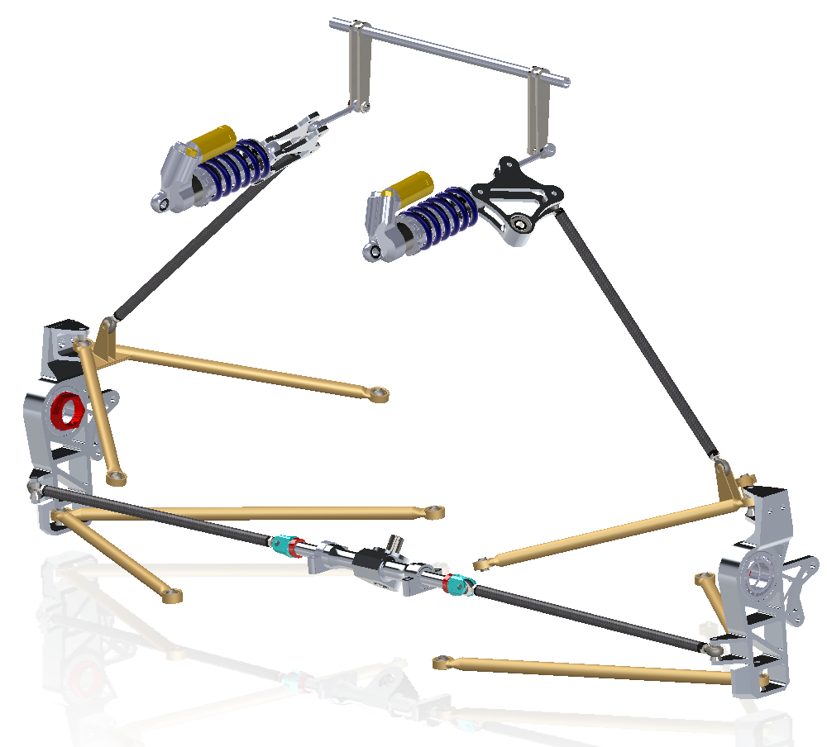
Suspension
Design Selections
Double wishbone pushrod
Double Wishbone Pushrod chosen for its better handling characteristics and lower unsprung weight
Geometry determined based on the following:
Other subsystem requirements (steering, chassis)
Phase 2 Readiness requirement (minimizing space taken up by anti-roll and other components)
Achieving desirable values for criteria such as KPI and scrub radius
Chassis
Steering
Brakes

Slide 20
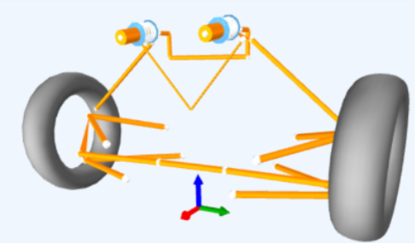
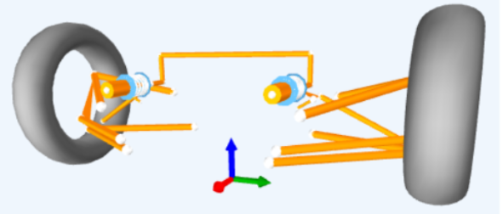
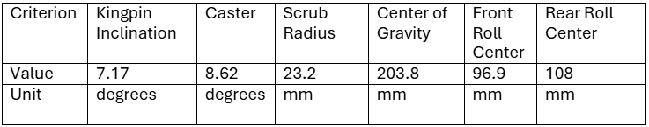
Suspension
Design Selections
Geometry values
Chassis
Steering
Brakes

Slide 21
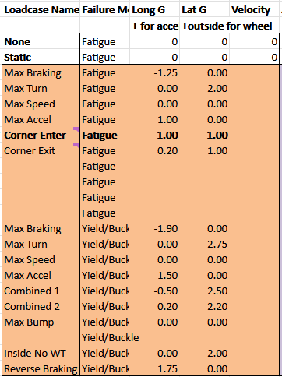
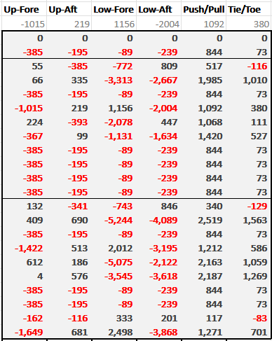
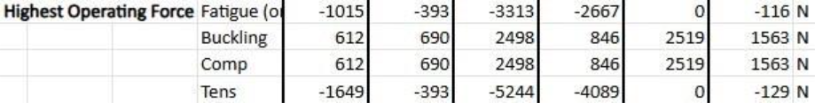
Suspension
Design Selections
Calculations
Chassis
Steering
Brakes
Spring Rate: 400lb/in

Slide 22
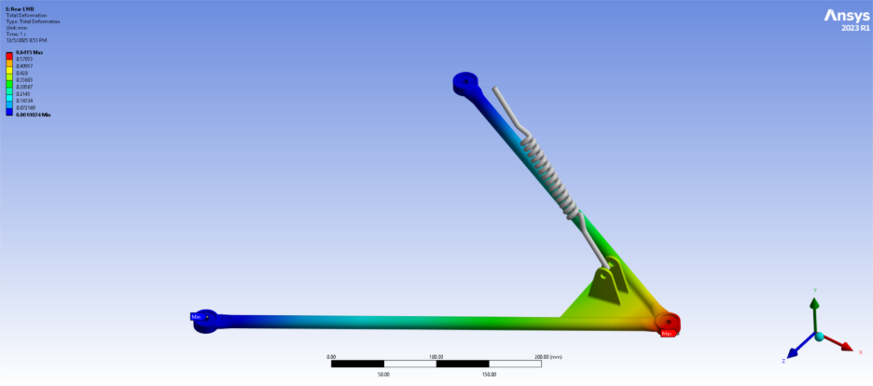
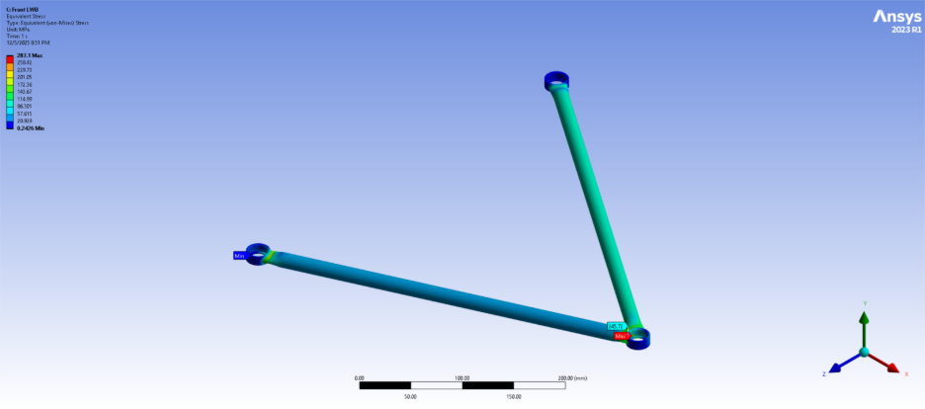
Suspension
Design Selections
Finite Element Analysis
Most stresses within suspension elements max out around 150MPa, within acceptable ranges.
Some high stress concentrations at the point in which the bearing cup welds to the wishbone rods
This is likely due to lack of weld material
Chassis
Steering
Brakes

Slide 23
Design Solutions
Suspension
Chassis
Steering
Brakes

Slide 24
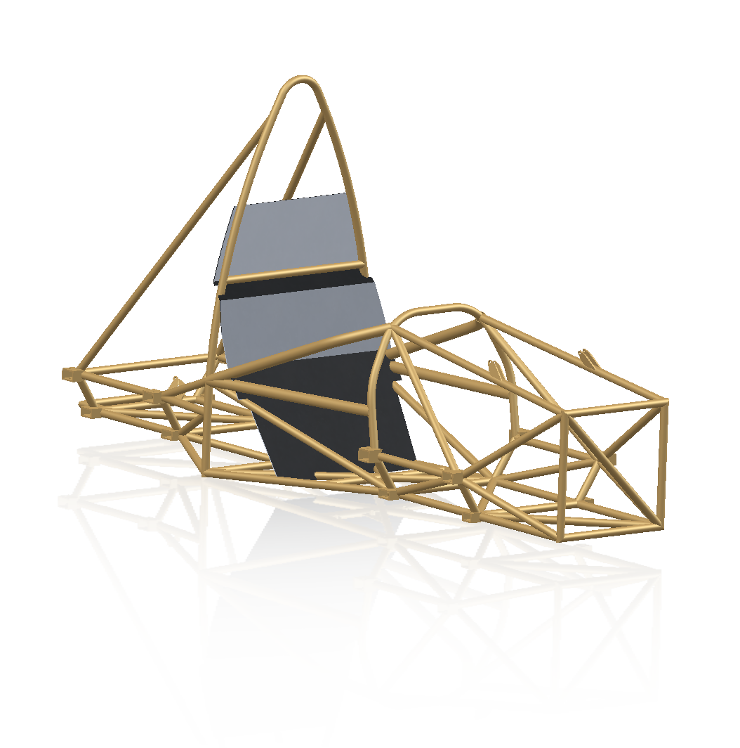
Chassis
Design Selections
Tubular space frame
Lower material and development cost
More predictable mechanical properties
Competitive weight and stiffness can still be achieved
Can iterate design quickly in CAD and FEA
Suspension
Steering
Brakes
Notes:
Briefly explain four chassis options (full steel, full carbon, carbon tub and front end with tube rear, tube frame with composite panel reinforcements).
Steel frames are a much more cost-effective option for first-year teams given their extensive documentation and use in FSAE competition.
Negative molds for a two-piece monocoque construction can cost as much as $15k, and cutting foam for a plug to use in a one-piece mold is time consuming and removing the foam could potentially compromise composite structure is done poorly with chemicals or mechanically.
Steel has predictable mechanical properties that don’t need as much design validation, composite structures in FSAE must pass extensive equivalency tests.
Competitive weights and chassis stiffness are still very achievable, even for a first-year team.
Designs are quicker to iterate in CAD after FEA than the surface modeling used for monocoques, where you also have to change the molds.

Slide 25
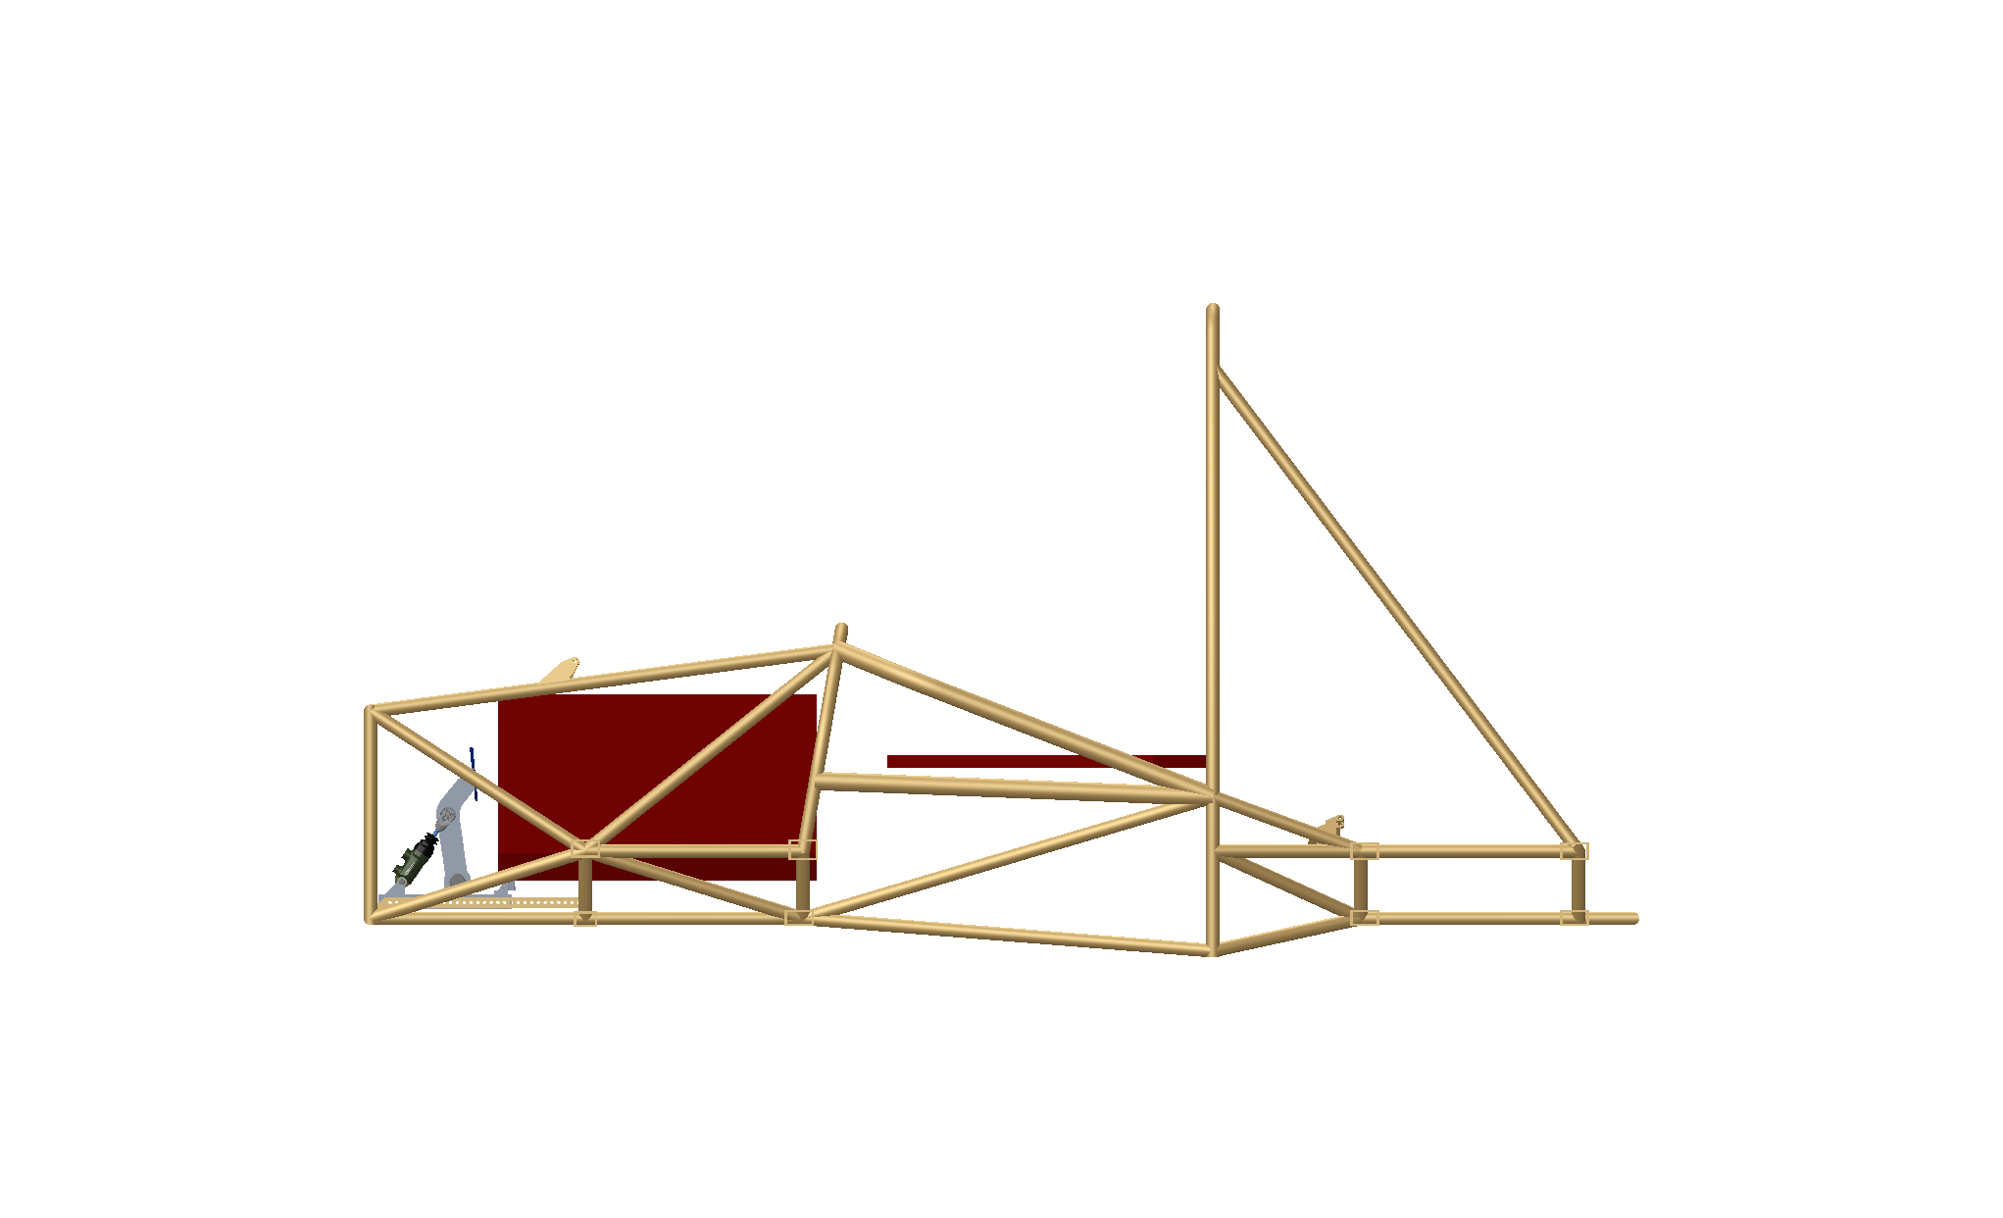
The 2025–2026 Formula SAE Rolling Chassis Project serves as the foundation for the vehicle that will eventually enter competition. Phase 1 focuses on constructing the car’s fundamental mechanical systems—its steel spaceframe, suspension, steering, and braking—forming a reliable platform for the next phase of development. From the earliest sketches to final design reviews, the team integrates relevant engineering standards and the 2026 FSAE Rulebook to ensure that every decision supports safe operation, manufacturability, and strong on-track performance.
Chassis
Design Selections
Design phase
Minimal number of bent members
Passes cross section pass-through and cockpit opening tests
Only needed three side impact structure members
Lightweight design: 44.3 kg, 32.8% of 135 kg target for rolling chassis
All 44.3 kg are recyclable
Suspension
Steering
Brakes
Notes:
Less bent members improves strength and lessens manufacturing challenges
Cross section and cockpit tests are the two most crucial dimensional challenges in FSAE, as you want to make the car as small as possible but still need the minimum size
Our design required only three side impact members to meet the dimensional criteria of the side impact structure. This is an accomplishment for a first-year team because it is difficult to design your frame to only use the minimum amount (3). Many teams have four, and some even have five members. This increases weight a considerable amount since the upper members are required to be made from the largest regulated tubing size.
Our frame comes in at just over 44 kg, only 33% of the target rolling chassis weight of 135 kg. This gives some flexibility to the other subsystems in their design and is overall a competitive weight.
One of customer requirements was to make at least 25% of the rolling chassis recyclable, stemming from either recyclable materials or parts like the brakes, shocks, pedal box and wheel uprights that can be used for more than one year. The chassis is made of steel and aluminum, the two most commonly-recycled materials, and it alone surpasses the customer requirement of 25%.

Slide 26
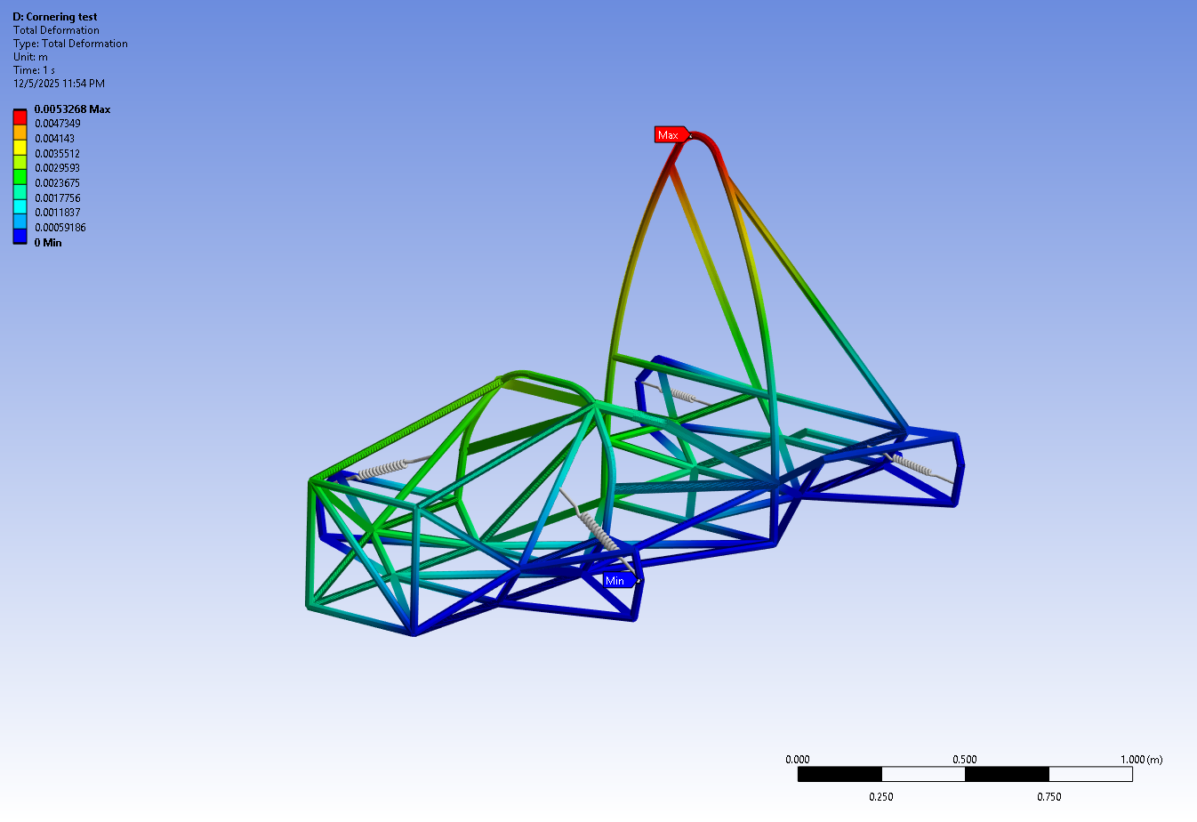
Chassis
Design Selections
Design validation
A lateral load of 1.7 G was applied about the car’s center of gravity.
5.3 mm of deflection was experienced at the top of the roll hoop.
Some members in the frame experienced small amounts of tension (~5 MPa).
The rest of the frame experienced compression (~37 MPa).
Suspension
Steering
Brakes

Slide 27
Design Solutions
Suspension
Chassis
Steering
Brakes

Slide 28
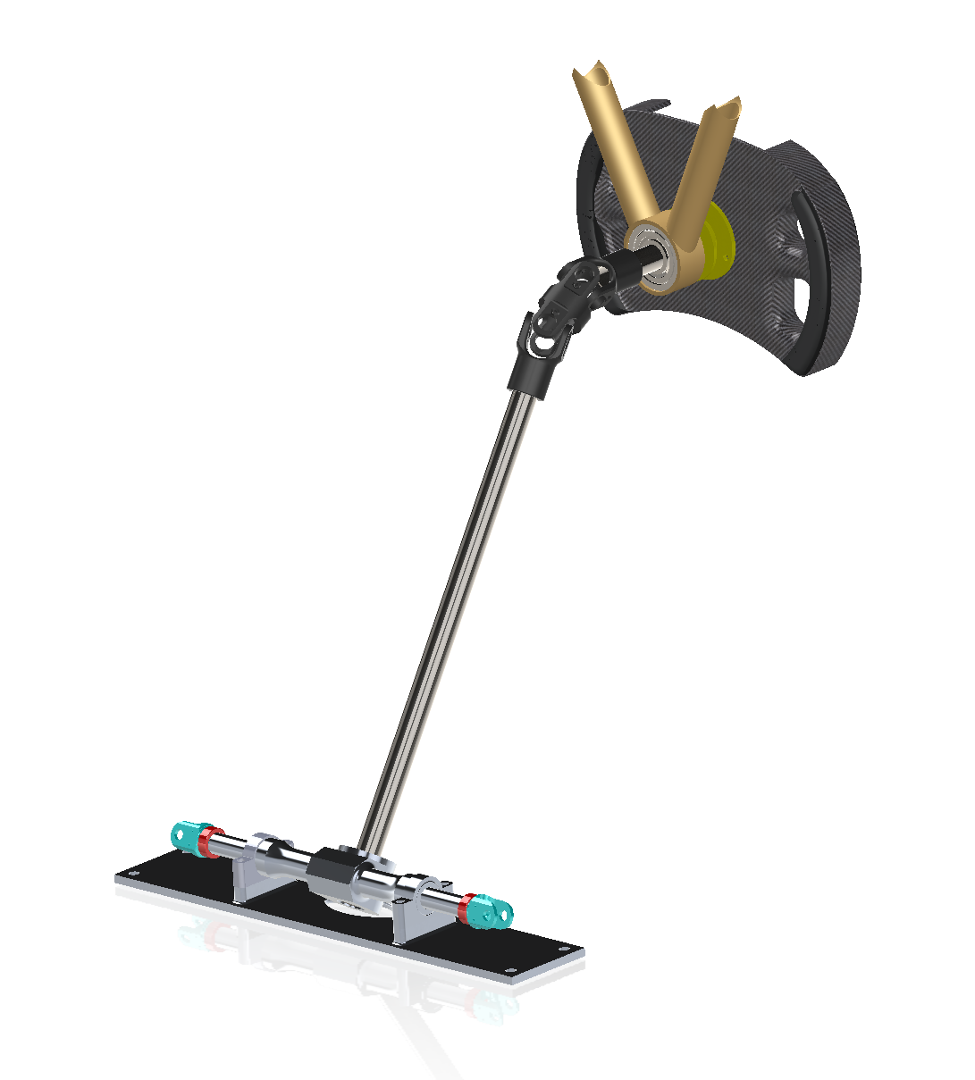
Steering
Design Selections
Rack & pinion
Steering rack was chosen for its lightweight and high precision construction.
Double U-Joint was chosen to allow steering wheel to be perpendicular to the ground.
Chassis
Suspension
Brakes

Slide 29
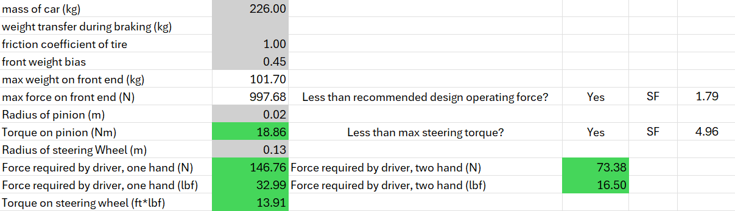
Steering
Design Selections
Steering force
Steering force was calculated from mass of the car and friction coefficient of tire.
Main concern was too heavy to turn and driver fatigue.
Chassis
Suspension
Brakes
Notes:
Steering force was found to be 18.86 Nm or 13.91 ft*lbs which would require 73.38 N or 16.50 lbs of force to rotate the steering wheel. From the internet, this is the force of a heavy bowling ball.

Slide 30
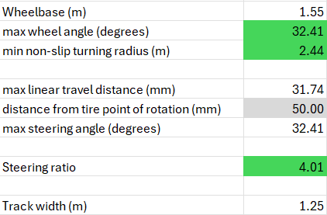
Steering
Design Selections
Steering ratio
Steering ratio was calculated from the angle of the steering wheel and vehicle wheels.
Team agreed it was a bit too fast.
Chassis
Suspension
Brakes
Notes:
solution is to insert a reversed steering quickener to double the steering ratio to 8.
Wheels respond quickly to the driver input

Slide 31
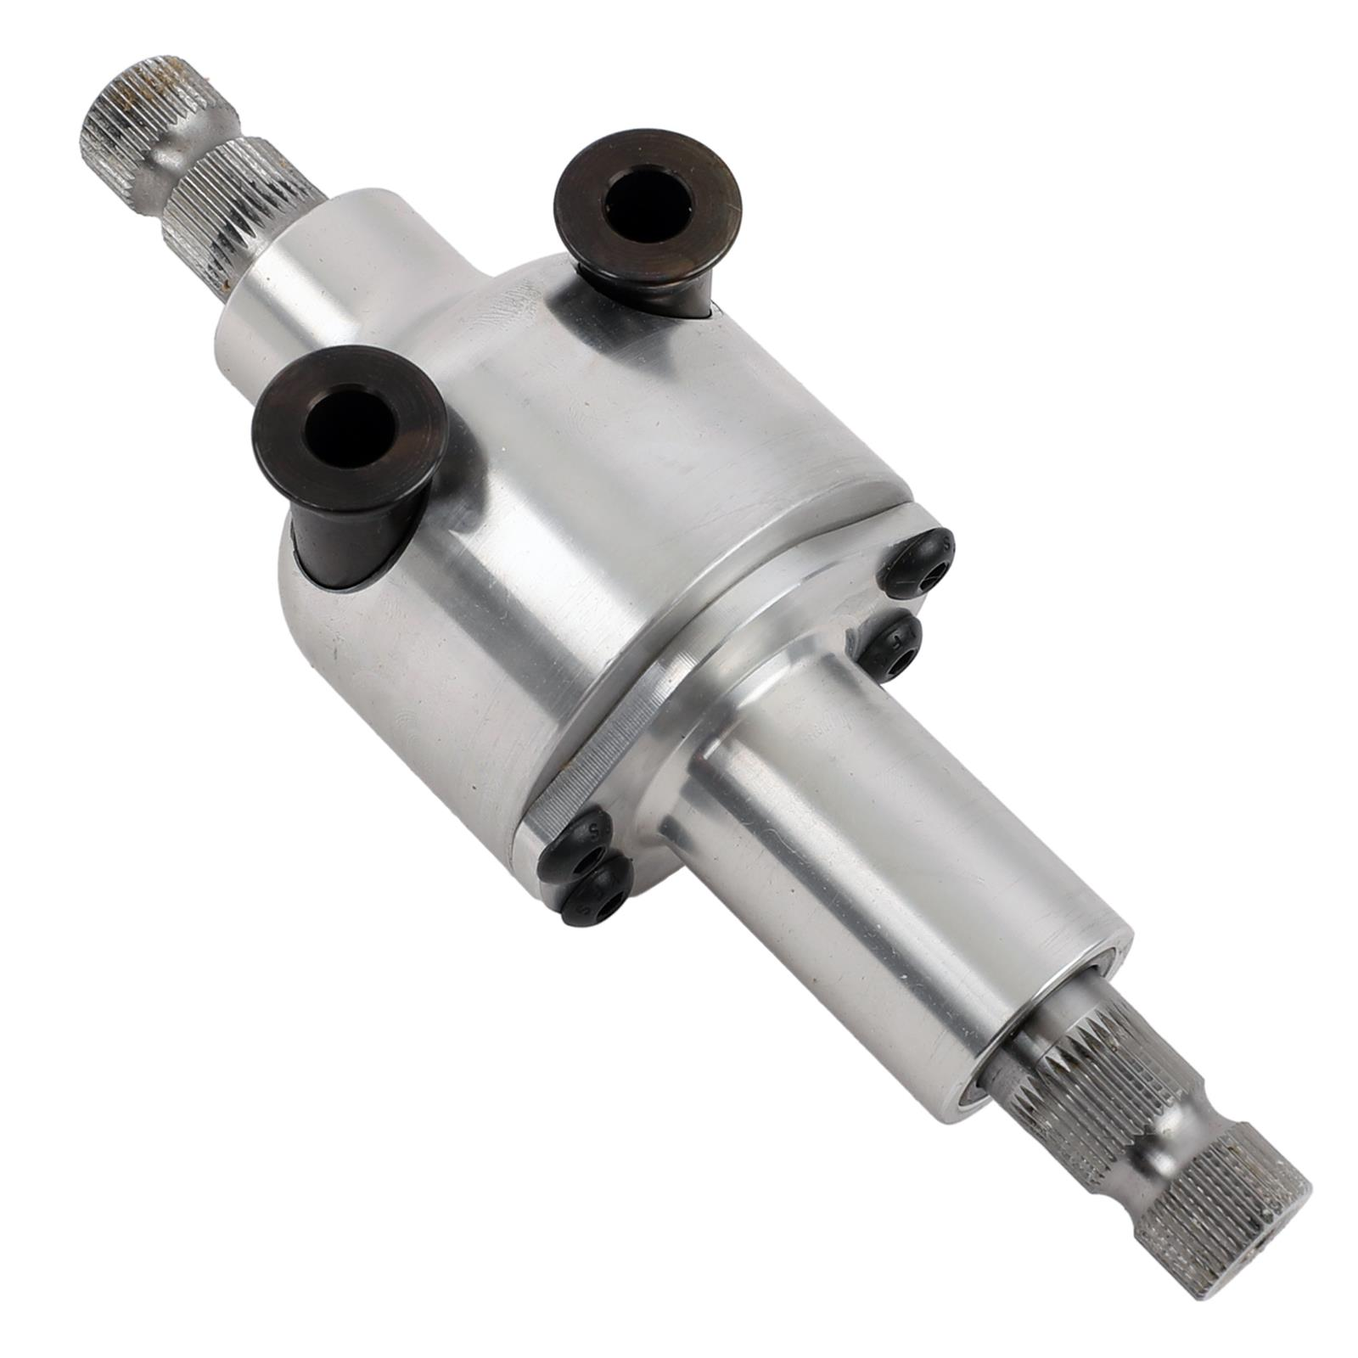
Steering
Design Selections
Testing & Validation
For testing, the driver will get a feel for the steering ratio.
The driver will also get a feel for the force required to rotate the steering wheel.
Chassis
Suspension
Brakes
Notes:
If steering ratio is too responsive, the steering quickener will be used.
The steering quickener will also increase the torque output of the driver if implemented.

Slide 32
Design Solutions
Chassis
Suspension
Steering
Brakes

Slide 33
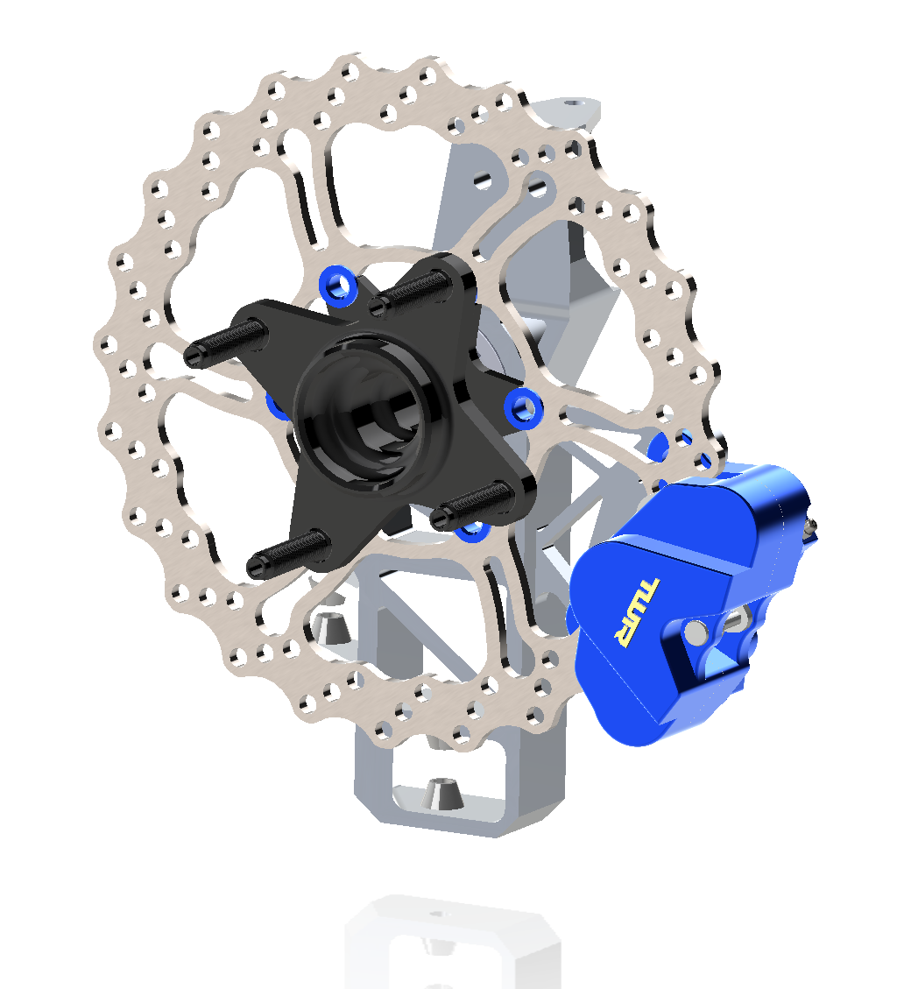
Brakes
Design Selections
Disc brakes
Disc brakes for better braking and removing complexity from center of car
Caliper placed low to contribute to lower center of gravity
Lightweight and Manufacturable
Chassis
Suspension
Steering

Slide 34
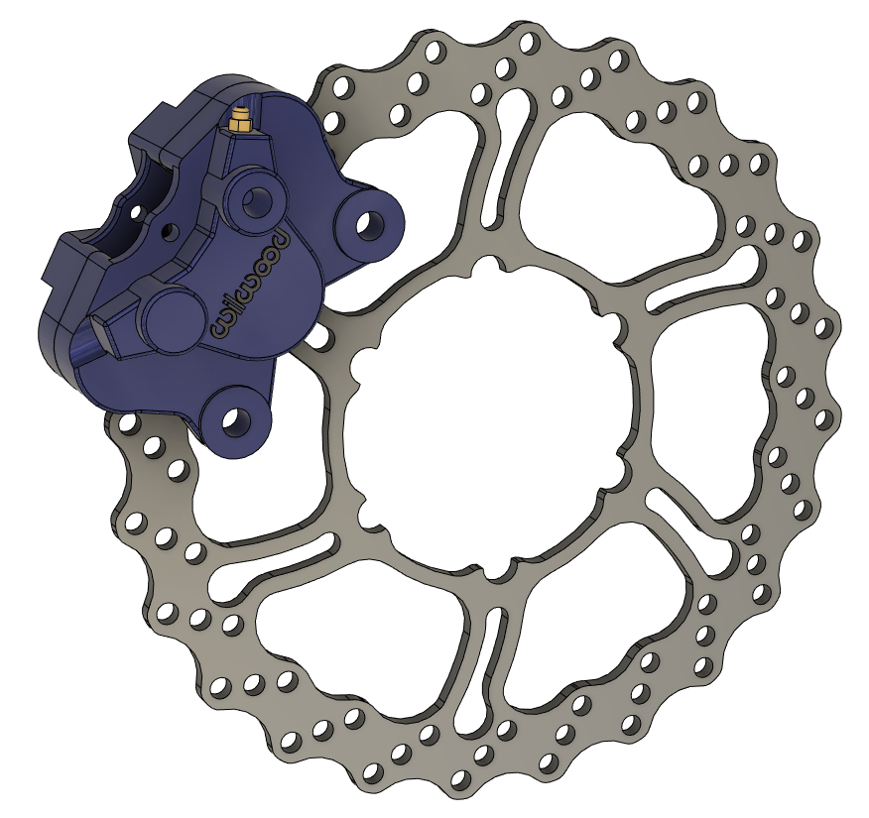
Brakes
Design Selections
Two Piston Calipers were used to provide strong clamping force in a small package
Using pads with a coefficient of friction ranging from 0.35-0.51
Calculated brake torque of 780 N
Brake calculations
Chassis
Suspension
Steering

Slide 35
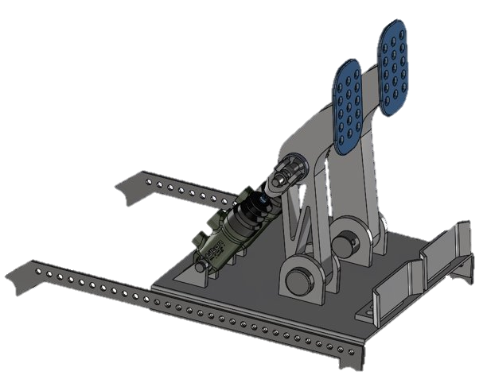
Brakes
Design Selections
Custom two pedal setup was used to reduce complexity and weight
Simple Design for easy replacement and improvements
Uses quick pin system for easy adjustment of position
Pedal Box
Chassis
Suspension
Steering

Slide 36
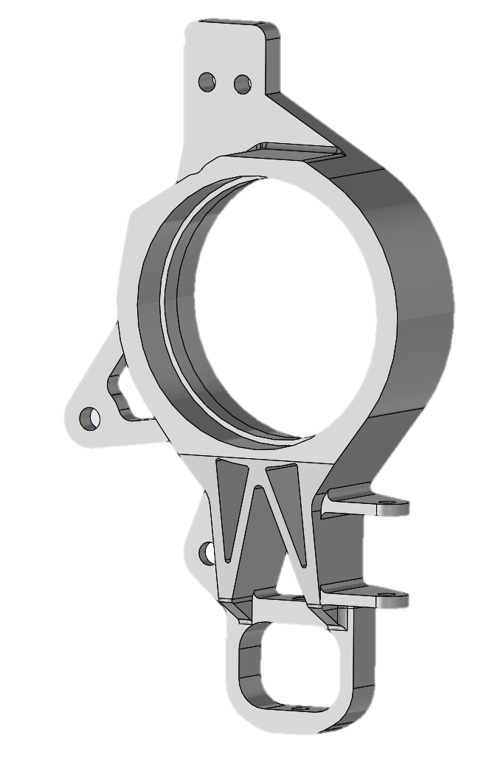
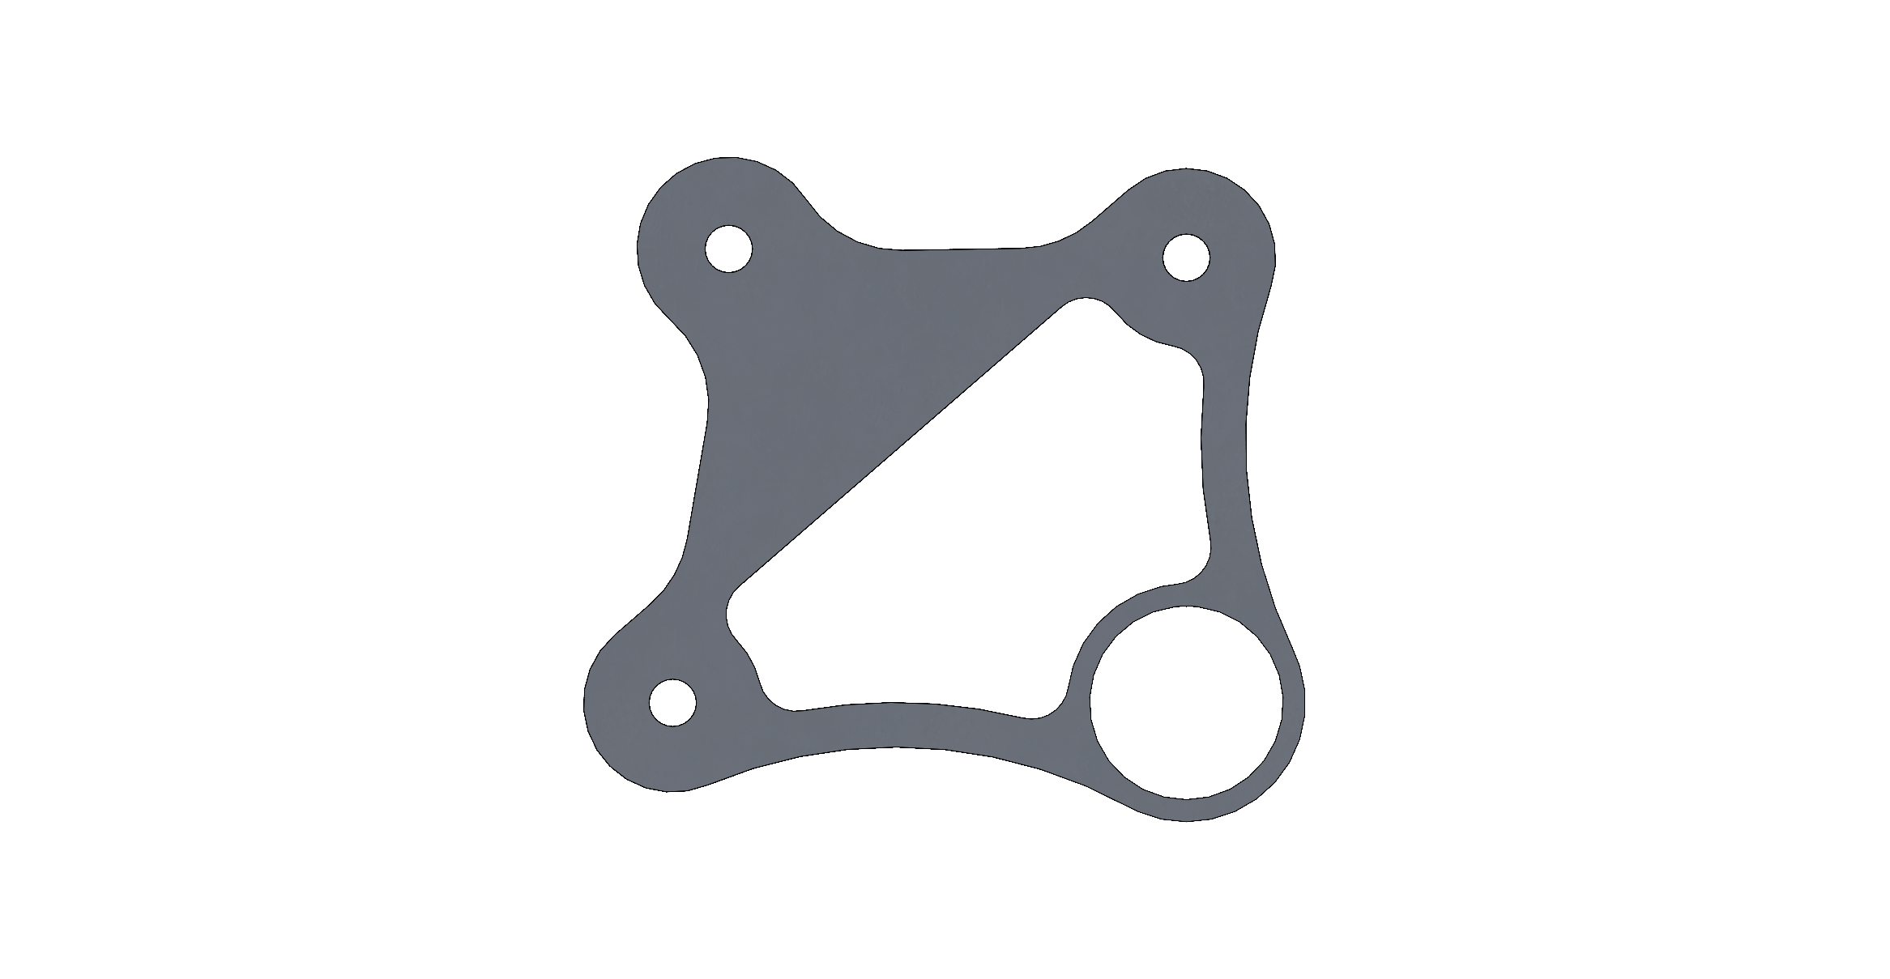
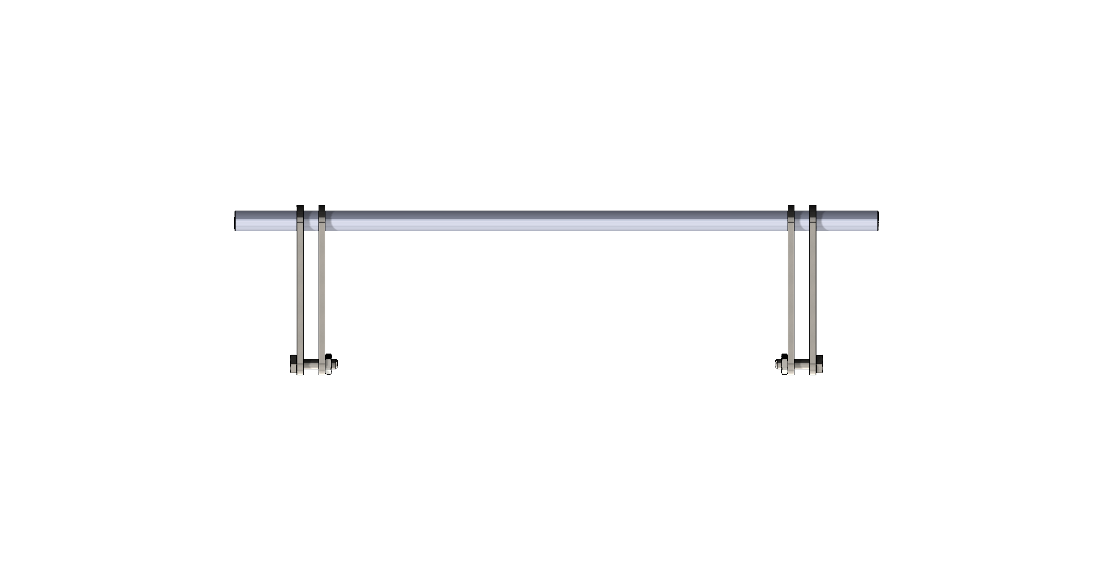
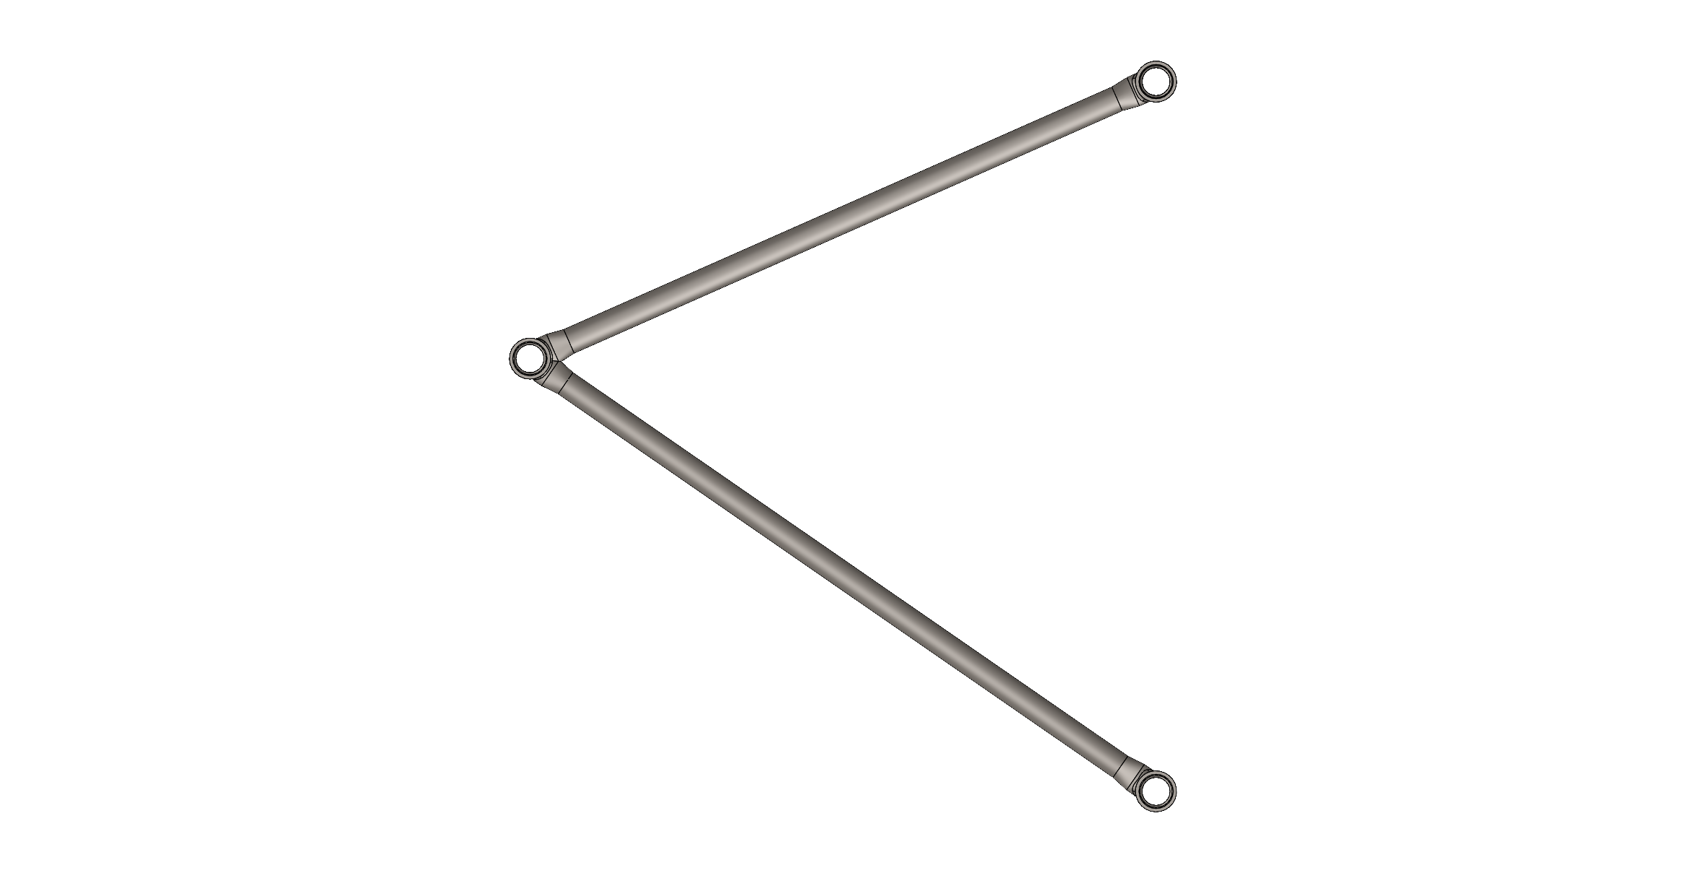
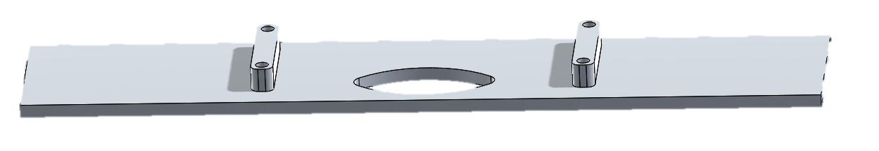
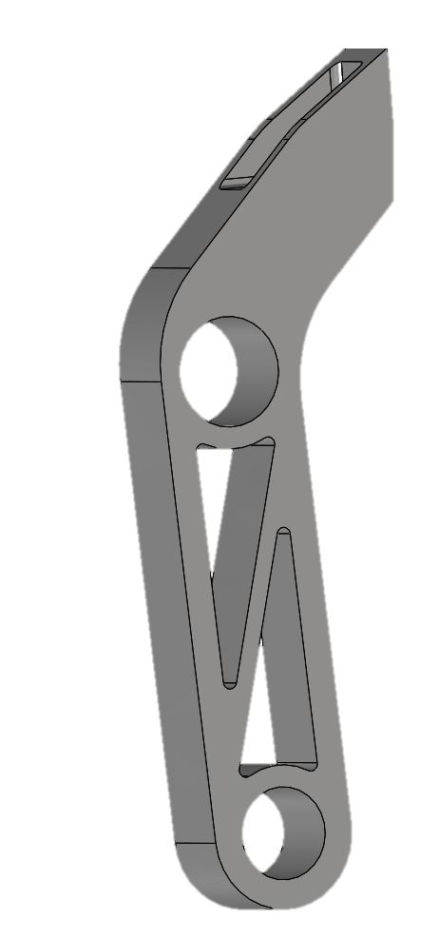
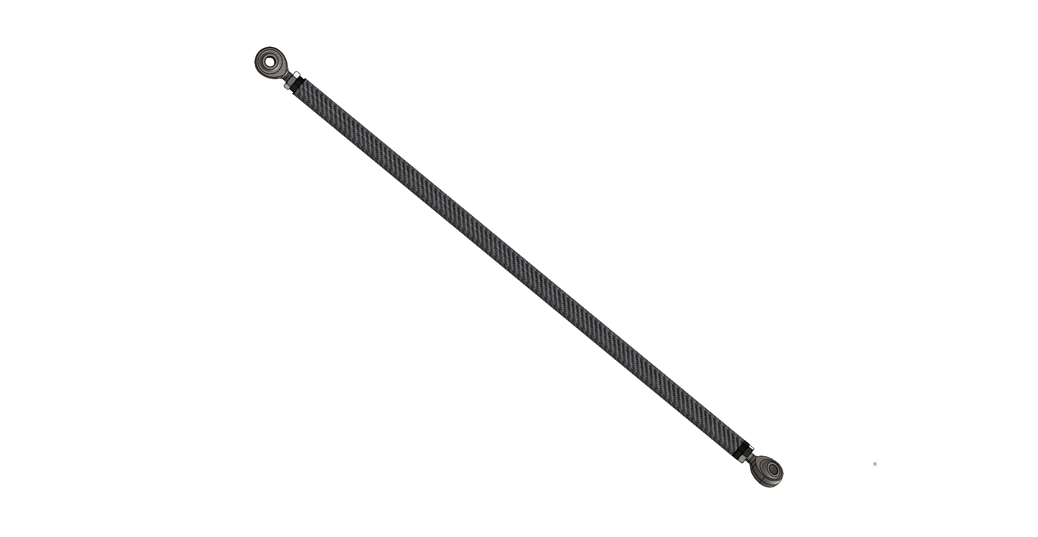
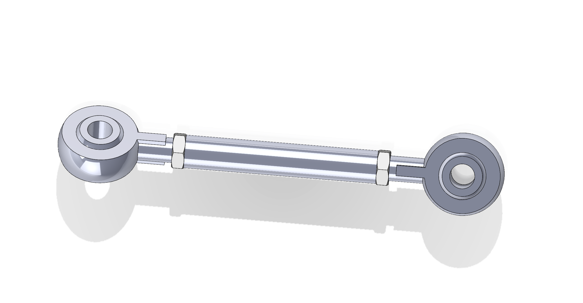
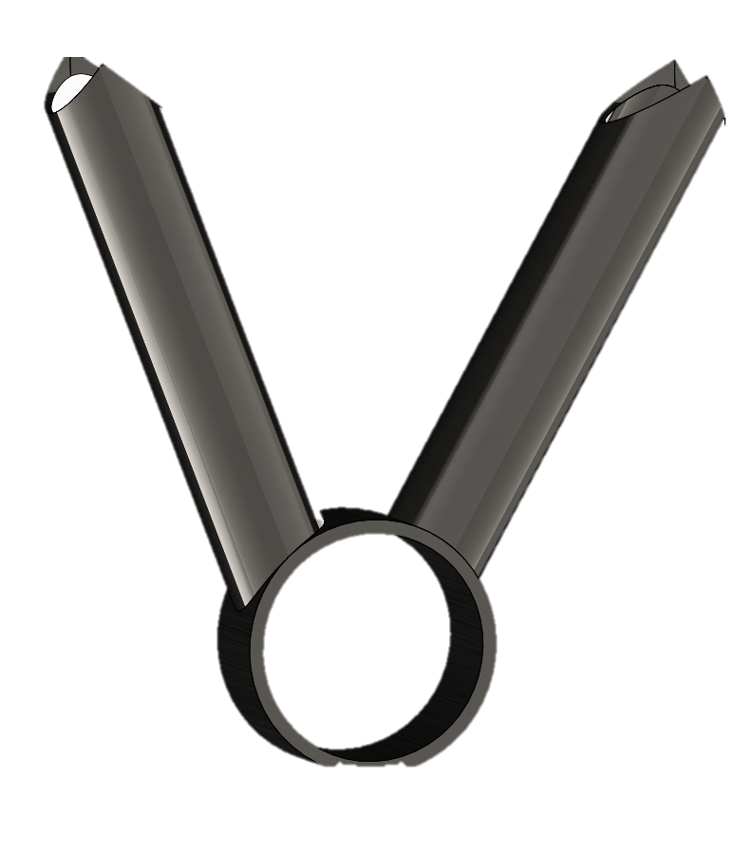
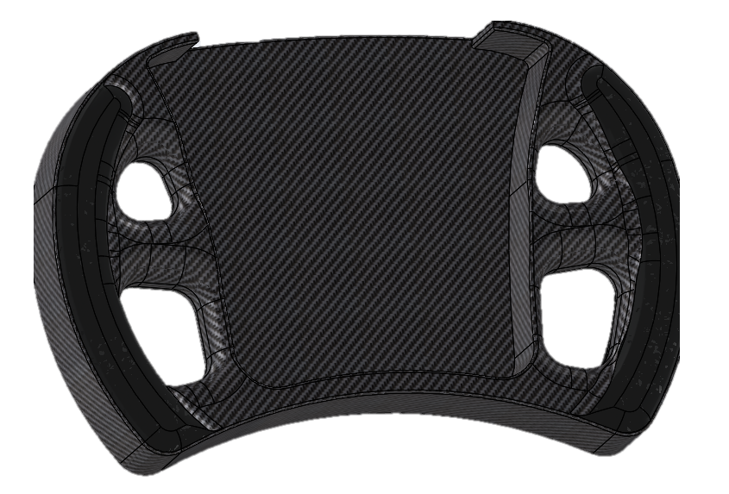
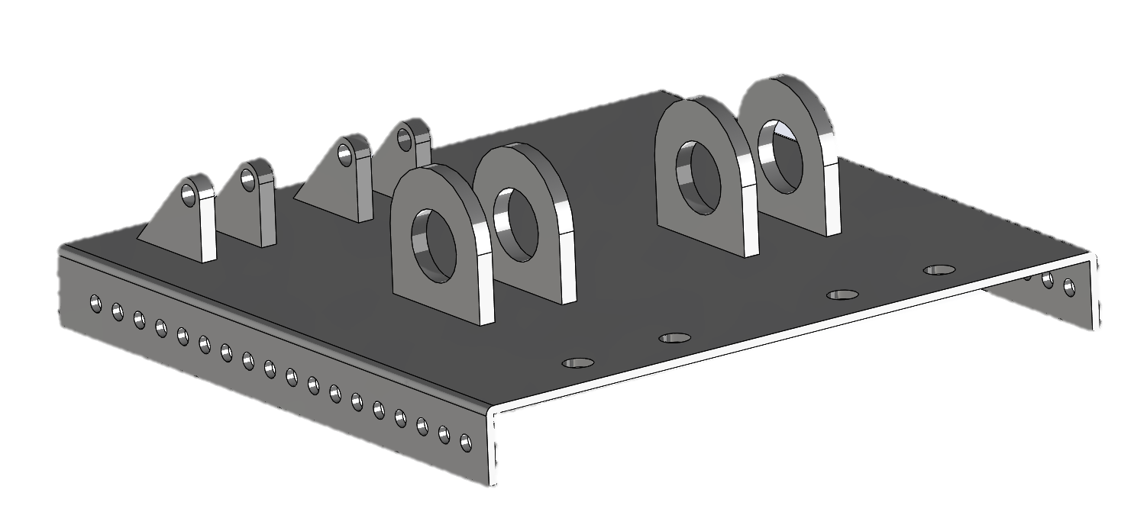
Suspension
Brakes
Upright
Steering
Chassis
D
C
Pedals
Pedal Box
B
Manufacturing Plan
Wishbones
Rocker
Anti Roll Link
Anti-Roll Bar
A
Pushrod
Steering Column Support
Steering wheel
Control Arms: Welded steel tubing with pressed in and bonded spherical bearings.
Pushrods: Carbon fiber tube with bonded in threaded inserts and rod ends.
Rocker: Metal 3D printed – 17-4 Stainless Steel
Anti-Roll: Steel tubing with waterjet made brackets welded together with standard swivel links.
Upright: CNC machined by our sponsor
Pedals: CNC machined by our sponsor
Pedal box: Bent aluminum plate with steel mounting brackets
Brake lines: Custom bent and flared
Steering Rack Mounting Plate: Foam/ Carbon Fiber Sandwich plate
Steering column support: Cut, notched, and welded 1020 carbon steel.
Steering wheel: Modular Carbon fiber steering wheel made with a CNC aluminum mold.
Cut and bent 1020 Carbon Steel tubing jigged and professionally welded.

Slide 37
Suspension
Brakes
Upright
Steering
Chassis
D
C
Pedals
Pedal Box
B
Manufacturing Plan
Wishbones
Rocker
Anti Roll Link
Anti-Roll Bar
A
Steering Column Support
Steering wheel
Pushrod
Control Arms: Welded steel tubing with pressed in and bonded spherical bearings.
Pushrods: Carbon fiber tube with bonded in threaded inserts and rod ends.
Rocker: Metal 3D printed – 17-4 Stainless Steel
Anti-Roll: Steel tubing with waterjet made brackets welded together with standard swivel links.
Upright: CNC machined by our sponsor
Pedals: CNC machined by our sponsor
Pedal box: Bent aluminum plate with steel mounting brackets
Brake lines: Custom bent and flared
Steering Rack Mounting Plate: Foam/ Carbon Fiber Sandwich plate
Steering column support: Cut, notched, and welded 1020 carbon steel.
Steering wheel: Modular Carbon fiber steering wheel made with a CNC aluminum mold.
Cut and bent 1020 Carbon Steel tubing jigged and professionally welded.

Slide 38
Suspension
Brakes
Upright
Steering
Chassis
D
C
Pedals
Pedal Box
B
Manufacturing Plan
Wishbones
Rocker
Anti Roll Link
Anti-Roll Bar
A
Steering Column Support
Steering wheel
Pushrod
Control Arms: Welded steel tubing with pressed in and bonded spherical bearings.
Pushrods: Carbon fiber tube with bonded in threaded inserts and rod ends.
Rocker: Metal 3D printed – 17-4 Stainless Steel
Anti-Roll: Steel tubing with waterjet made brackets welded together with standard swivel links.
Upright: CNC machined by our sponsor
Pedals: CNC machined by our sponsor
Pedal box: Bent aluminum plate with steel mounting brackets
Brake lines: Custom bent and flared
Steering Rack Mounting Plate: Foam/ Carbon Fiber Sandwich plate
Steering column support: Cut, notched, and welded 1020 carbon steel.
Steering wheel: Modular Carbon fiber steering wheel made with a CNC aluminum mold.
Cut and bent 1020 Carbon Steel tubing jigged and professionally welded.

Slide 39
Suspension
Brakes
Upright
Steering
Chassis
D
C
Pedals
Pedal Box
B
Manufacturing Plan
Wishbones
Rocker
Anti Roll Link
Anti-Roll Bar
A
Pushrod
Steering Column Support
Steering wheel
Control Arms: Welded steel tubing with pressed in and bonded spherical bearings.
Pushrods: Carbon fiber tube with bonded in threaded inserts and rod ends.
Rocker: Metal 3D printed – 17-4 Stainless Steel
Anti-Roll: Steel tubing with waterjet made brackets welded together with standard swivel links.
Upright: CNC machined by our sponsor
Pedals: CNC machined by our sponsor
Pedal box: Bent aluminum plate with steel mounting brackets
Brake lines: Custom bent and flared
Steering Rack Mounting Plate: Foam/ Carbon Fiber Sandwich plate
Steering column support: Cut, notched, and welded 1020 carbon steel.
Steering wheel: Modular Carbon fiber steering wheel made with a CNC aluminum mold.
Cut and bent 1020 Carbon Steel tubing jigged and professionally welded.

Slide 40
Suspension
Brakes
Steering
Chassis
D
C
B
Manufacturing Plan
Wishbones
Rocker
Anti Roll Link
Anti-Roll Bar
A
Pushrod
Steering Column Support
Steering wheel
Control Arms: Welded steel tubing with pressed in and bonded spherical bearings.
Pushrods: Carbon fiber tube with bonded in threaded inserts and rod ends.
Rocker: Metal 3D printed – 17-4 Stainless Steel
Anti-Roll: Steel tubing with waterjet made brackets welded together with standard swivel links.
Pedal Box
Steering Rack Mounting Plate: Foam/ Carbon Fiber Sandwich plate
Steering column support: Cut, notched, and welded 1020 carbon steel.
Steering wheel: Modular Carbon fiber steering wheel made with a CNC aluminum mold.
Upright
Pedals
Upright: CNC machined by our sponsor
Pedals: CNC machined by our sponsor
Pedal box: Bent aluminum plate with steel mounting brackets
Brake lines: Custom bent and flared
Cut and bent 1020 Carbon Steel tubing jigged and professionally welded.

Slide 41
Suspension Tests:
Overall Travel
Binding Test
Wheelbase
Track Width
Ground Clearance
Chassis Tests:
Stiffness
Tilt Test
G-Test
Brake Tests:
Functionality and Lockup
Steering Tests:
Free Play
Steering Forces
01. Suspension
02. Chassis
03. Steering
04. Brakes

Slide 42
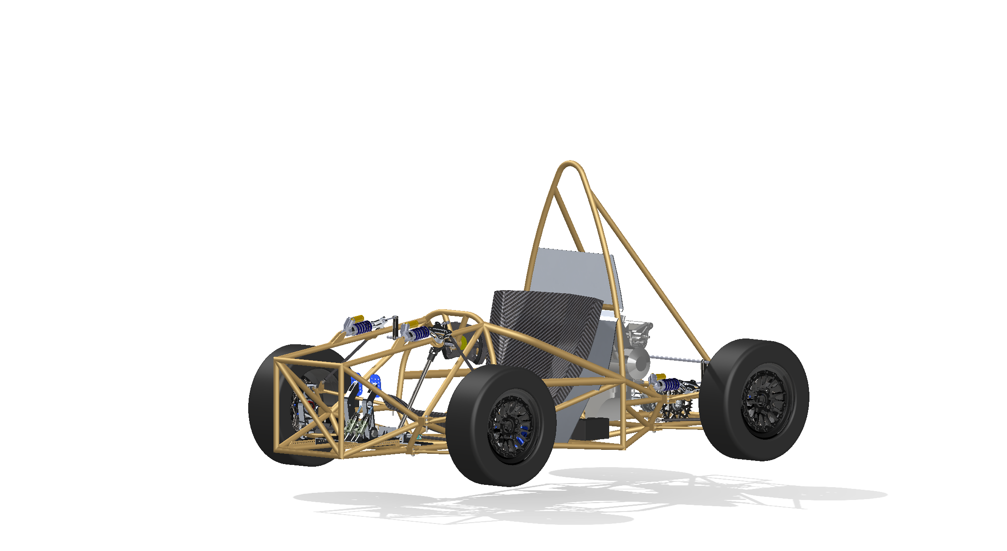
Phase 2 Readiness
1
Engine type and location
2
Fuel cell
3
Battery
4
Differential placement

Slide 43
Phase 2 Readiness
1
Engine type and location
2
Fuel cell
3
Battery
4
Differential placement

Slide 44

GANTT CHART TIMELINE
Spring semester
1/15-2/20
1/19-1/25
Frame Manufacturing
Steering Manufacturing
1
2
3
4
Suspension Manufacturing
Brakes Manufacturing
1/15-2/20
1/25-2/13

Slide 45


3/16-4/19
4/24
Shakedown
Corrections
Senior Design Expo
5
6
7
8
Preliminary
Shake-down
Final testing
3-15
4/19

Slide 46
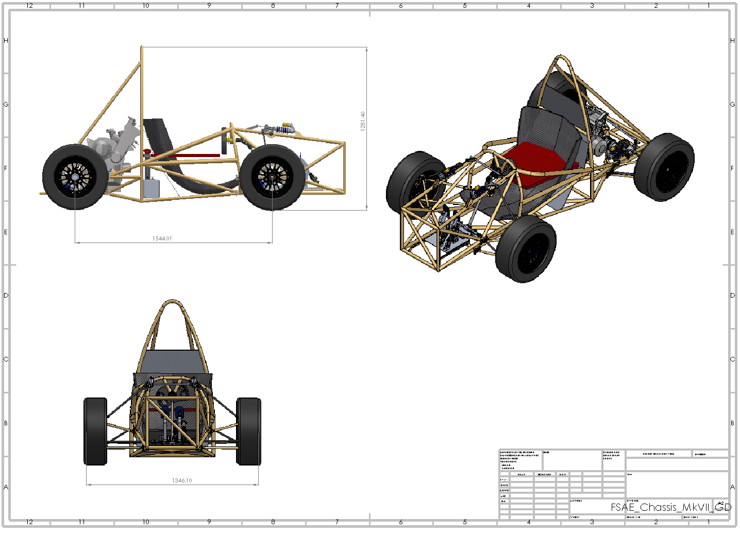

Slide 47
LABOR/MATERIALS
PROJECT BUDGET
$6,250
CASH
PART DISCOUNT
$735.87
$13,000
TOTAL NEEDED
$-1250
02
03
01
04

Slide 48
PROJECT BUDGET
LABOR/MATERIALS
$6,250
CASH
PART DISCOUNT
$735.87
$13,000
02
03
01
TOTAL NEEDED
$-1250
04

Slide 49

Customer Requirements
Design a chassis capable of pulling 1.5g during cornering (in steady state).
Design a rolling chassis with a weight under 135 kg.
Design must complete all Phase One subsystems
Phase One: Frame, Suspension, Brakes, Steering
Phase Two: Powertrain, Drivetrain, Aero package, Electronics
Design must allocate space for Phase Two subsystems by allowing a minimum of 10% tolerance beyond the estimated size of the components.
Design must accommodate drivers from any size between the 5% female (5' tall) and 95% male (6' 1") percentiles.
Design a chassis that twists less than 20% roll compliance at maximum lateral load.

Slide 50

Customer Requirements
Design must pass 100% of the practical FSAE Tech tests applicable to Phase One subsystems.
Design must be completed by April 24, 2026.
There must be 0 safety infractions during the design and manufacture of the rolling chassis.
A minimum of $18,000 must be raised for the project.
Vehicle does not roll when tilted 60 degrees to the horizontal, corresponding to 1.7g cornering.​
Design must be made such of 25% or more of the rolling chassis weight is recyclable at the end of the vehicle’s life cycle.​

Slide 51
